Slide 1

.
Nagarjuna College of Engineering and Technology
Information Science and Engineering
“College Enquiry Chatbot”
Under the Guidance of Presented by
Ms. Nethra. B.R. 1NC20IS003 Ankitha. G. S.
1NC20IS008 Dikshita Chilukuri .
1NC20IS023 Navya.K.
1NC20IS037 Soundary.B.M.

Slide 2
CONTENTS
Abstract.
Introduction.
Literature survey.
Proposed system advantages.
Block diagram and Features.

Slide 3
Abstract
Chat bots are improving the way of communication in the virtual world. Chat bots are nothing but AI assistants. Chat bots typically provide a textbased user interface, allowing the user to type commands and receive text as well as text to speech response. This project titled as “College Enquiry Chatbot” focuses on some of the key issues like it avoids the user to personally go to the college for enquiry about college activities, to minimize the load of officers of universities and increase interaction between student and college without actually involving any physical human entity that can promote student engaging system with greater user interface and quick response and aims to develop a college enquiry chat bot that answers any queries post by students like college details, course-related questions, location of the college, fee structure etc. The college enquiry chat bot project is built using python libraries that analyze user’s queries and understand the user’s message. The system analyzes the question and then answers to the user. The user can also give their suggestions through the feedback. This chatbot is mainly used in college by the students for collecting college related activities.

Slide 4
Introduction
Chat-bot also known as a talk bot, chatterbox. A Bot is a computer program that mimics human conversations.
A bot also refers to as a software which performs tasks automatically. Basically a bot is a computer program designed for communication and to get answers through that communication.
A chatbot is an AI program that copy human discussions including content and communication in natural language utilizing artificial intelligence method for example, Natural Language Processing is a picture and video processing and voice analysis.
chatbot for college management system has been created utilizing Python libraries that examine the user queries. This chatbot system is an internet application that gives an answer to the broken down queries of a user.

Slide 5
Chatbot has become the center of focus in this current era thus the bot are being utilized to deliver information more conveniently.
A chatbot is a standout amongst the most progressive and promising tools of communication among people and machines. famous chatbots like amazon Alexa, Siri, Facebook, Slack, and many more are in trend. These are very much helpful but in this era of enhancing technology day by day, technology gets updated and accordingly by the user expectations also increases.
A chatbot can be described as an answering system where a system will be able to answer questions or to the statement submitted by users and allow users to control over the content to be displayed.

Slide 6
Literature survey.

Slide 7
Proposed system advantages.
The system replies using an effective Graphical User Interface which implies that as if a real person is talking to the user and can make available 24 x 7. Anyone, Anywhere, Anytime without any problem can make use of internet connection and mobile device or other laptop devices to solve doubts. The motive of the chatbot is to generate a quick response within less time to the user’s query and reduce the workload of the management system. This chatbot is mainly used in college by the students for collecting college related activities.
No barrier for asking questions.
Fast answer guaranteed.
Minimize cost and time saving.
Welcoming communication medium for the target audience.
Analytic insights and working without mistakes.
Easy to use and communicate.

Slide 8
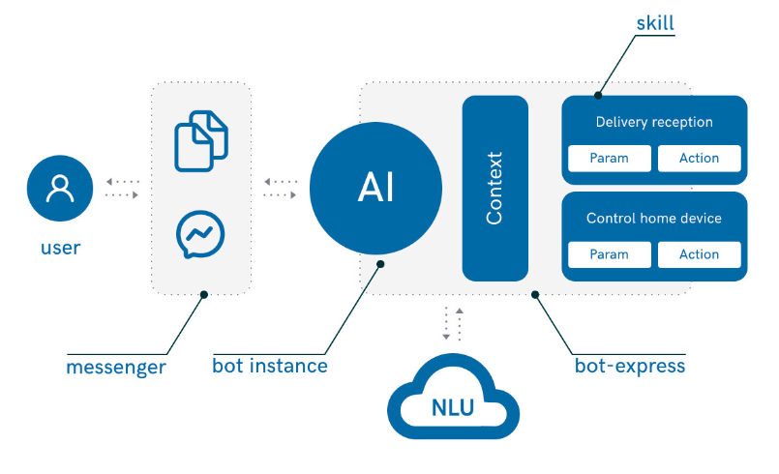
Block diagram.
.

Slide 9
.
THANK YOU.

